Slide 1
Email Marketing Data Analysis (EDA in Python)
Objective:
The objective of this project is to analyze customer enrollment and engagement data from an email marketing campaign to understand demographic patterns, data quality issues, and participation trends. The analysis focuses on cleaning inconsistent data, identifying missing or incorrect values, and visualizing customer distribution across cities, states, genders, and statuses to support better marketing targeting and campaign optimization.

Slide 2
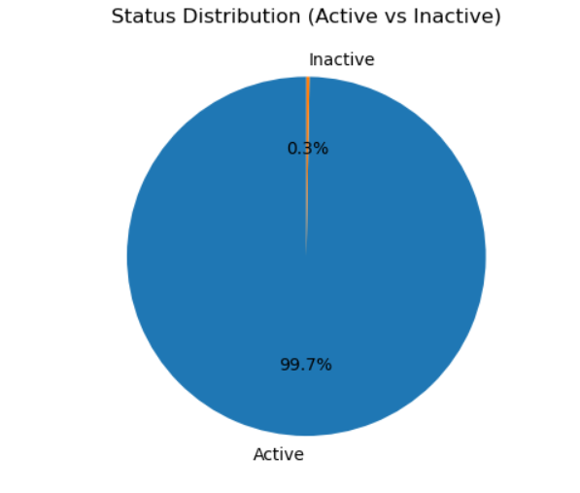
🔹 Plots & Explanations
Status-wise Distribution Plot – Displays active vs. inactive customer counts, providing insight into engagement levels.

Slide 3
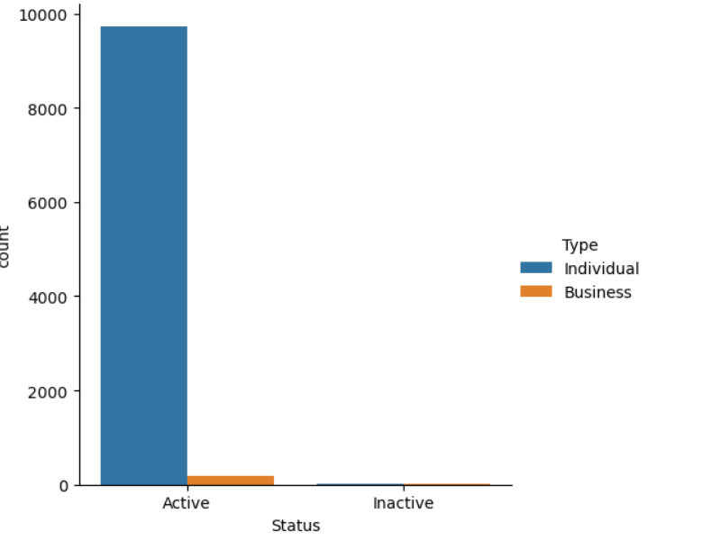
🔹 Plots & Explanations
2.Type-wise Distribution Plot – Displays active vs. inactive customer counts In Individual & Business, providing insight into engagement levels.

Slide 4
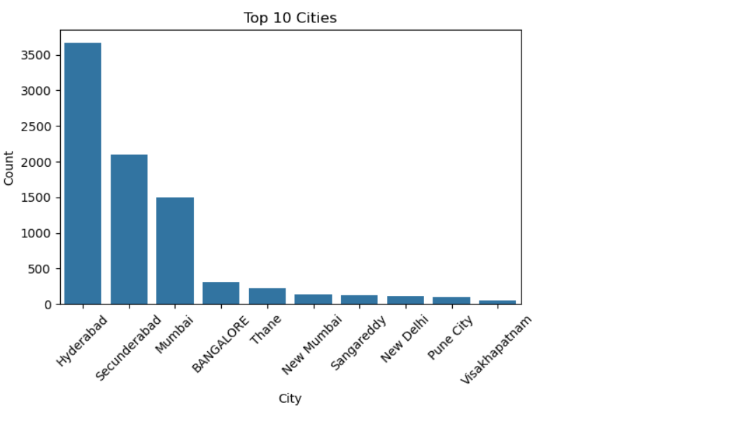
🔹 Plots & Explanations
3.City-wise Distribution Plot – Shows how customer enrollments vary across cities, highlighting regions with the most active participation.

Slide 5
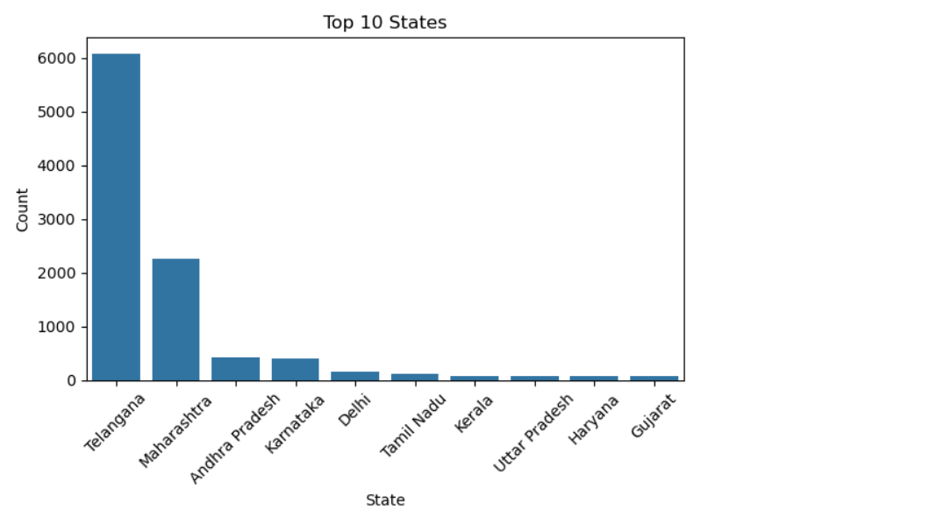
🔹 Plots & Explanations
5.State-wise Distribution Plot – Visualizes enrollment distribution by state, helping identify location-based marketing opportunities.

Slide 6
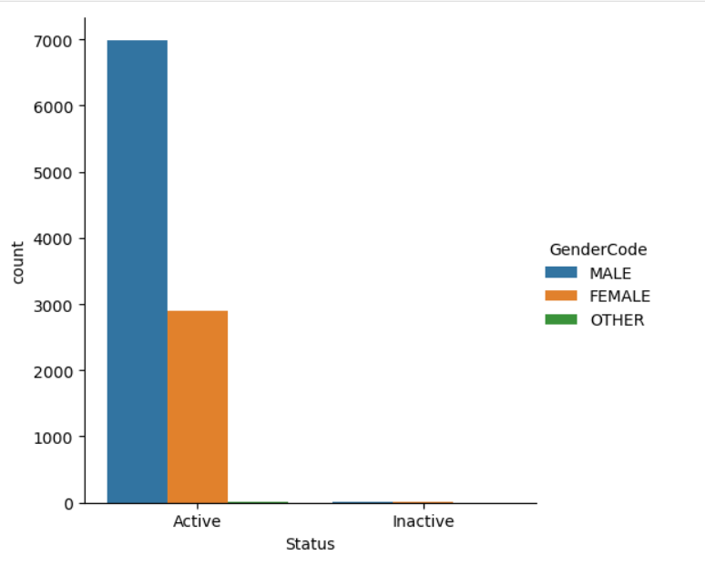
🔹 Plots & Explanations
6.Gender-wise Enrollment Plot – Compares the number of male vs. female participants to assess demographic balance.

Slide 7
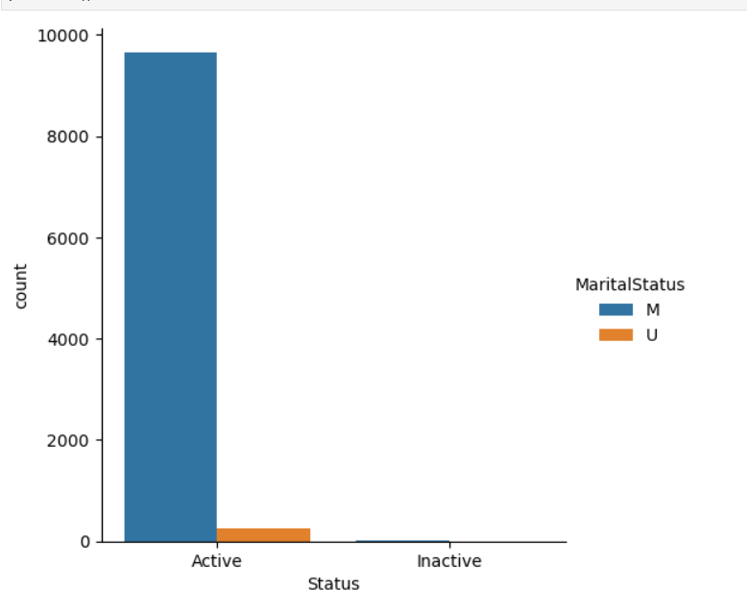
🔹 Plots & Explanations
7.Marital Status wise Status:compares how many married and unmarried.

Slide 8
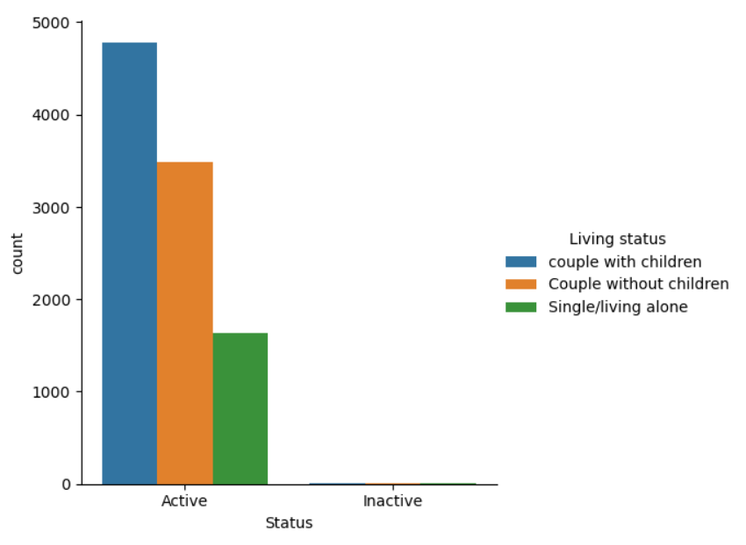
🔹 Plots & Explanations
Living Status Distribution Plot – Shows how couple with/without,single/alone are in Active & Inactive.

Slide 9
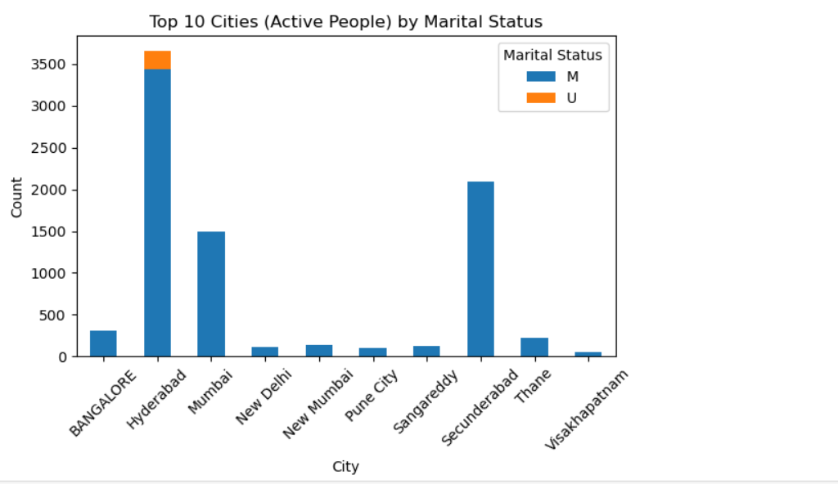
🔹 Plots & Explanations
Top 10 Cities(Active) by Marital Plot – Shows how Active customer enrollments vary across cities, highlighting Marital status with the most active participation.

Slide 10
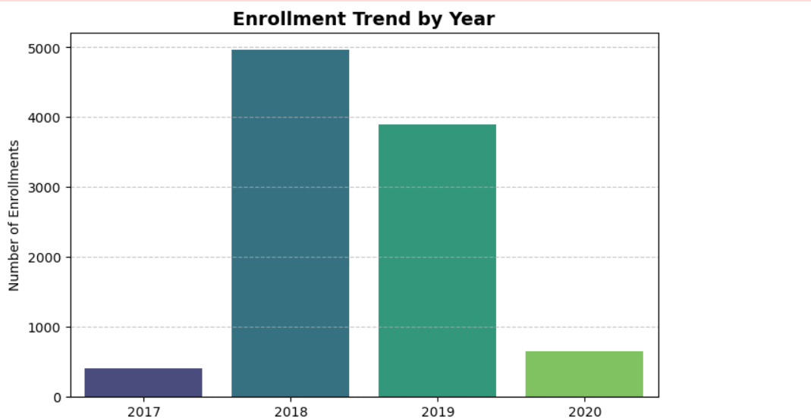
🔹 Plots & Explanations
Enrollment Trend by Year Plot – Shows how customer enrollments vary Year by Year.

Slide 11
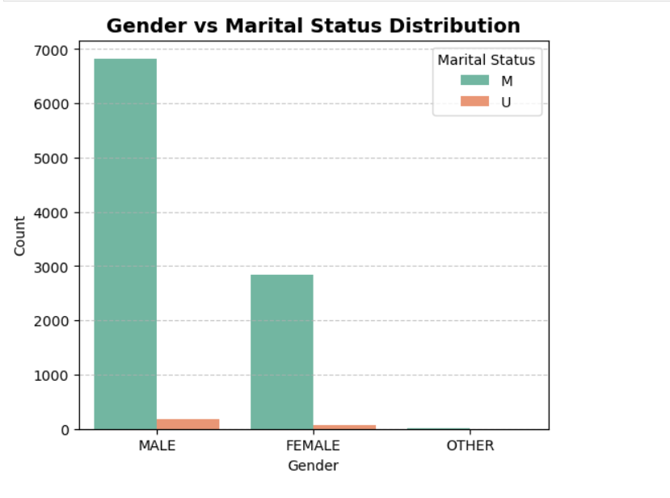
🔹 Plots & Explanations
Plot Shows how Gender( male vs female),Marital status are engaged.

Slide 12
📈 Key Insights
✅ Active cities show higher engagement ✅ Gender balance skewed toward males ✅ Missing data mostly in City and State columns ✅ Around 20% inactive users — need re-engagement strategy

